Slide 1
Cellular respiration

Slide 2
Do Now: Homework:
Objectives: Summarize how glucose is broken down in the first stage of cellular respiration. Describe how ATP is made in the second stage of cellular respiration.
What kinds of organisms undergo cellular respiration?
What is/are the final product(s) of photosynthesis?
back side of 9-1 homework packet

Slide 3
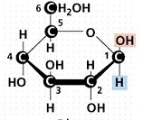
Photosynthesis
Capture energy from sunlight to make food (glucose)
http://206.173.89.42/REALTYWITHALOHA_COM/piphoto/funny%20sun%20with%20sunglasses.gif

Slide 4
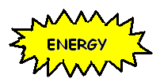
Cellular respiration
Releasing the energy from food (glucose) to make ATP
Slow; many steps
What if all energy was released at once?
What do you notice about this???
C₆H₁₂O₆
6O₂
6 CO₂
6 H₂O
_____________ + _________ →________ + __________ + __________
Notes:
Would be released as heat and light

Slide 5
Cellular Respiration
ALL organisms perform
To store and release energy
Where????
Oxidizes food molecules into CO₂ and H₂O
Uses oxygen to break the bonds
Aerobic – uses oxygen
Anaerobic – doesn’t use oxygen

Slide 6
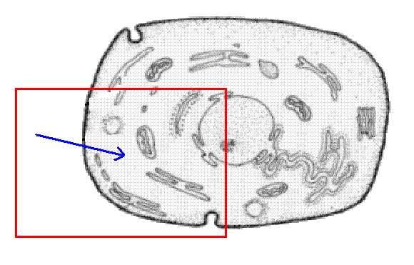
Stage one - glycolysis
In cytoplasm outside mitochondria
Needs energy to get started
Where does this come from??
What is made?

Slide 7
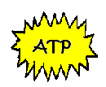
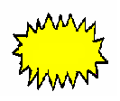
Glycolysis
________
↓
→ →
↓
GLUCOSE
2 PYRUVIC ACID
+
ATP ATP ATP ATP
NADH NADH
Notes:
Put in: 2 ATP, get out: 4 ATP
Gain: 2 ATP & 2 NADH

Slide 8
Do Now: Homework:
Objectives: Summarize how energy is released in the second stage of C.R.
Identify the role of fermentation in the second stage of C.R.
Where does the energy to get Glycolysis started come from (be specific!!)
Distinguish between aerobic and anaerobic respiration.
Read pages 104-107
CC & S
Worksheet (edline)
TEST WEDNESDAY!!!

Slide 9
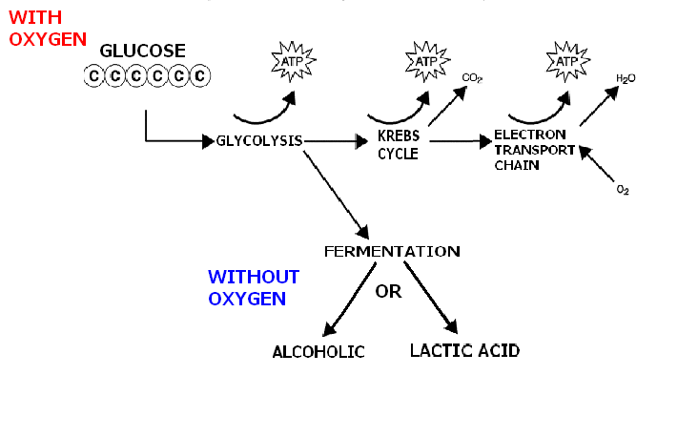
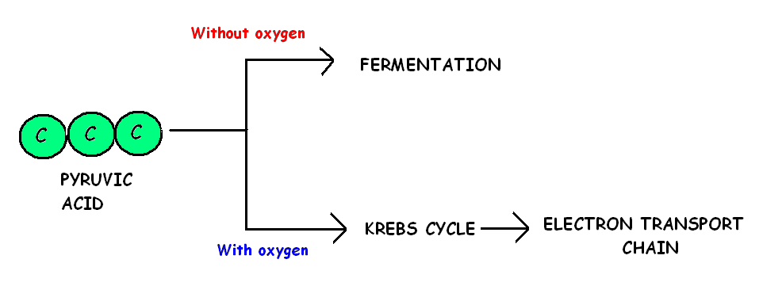
Stage Two
Pyruvic acid moves to next stage

Slide 10
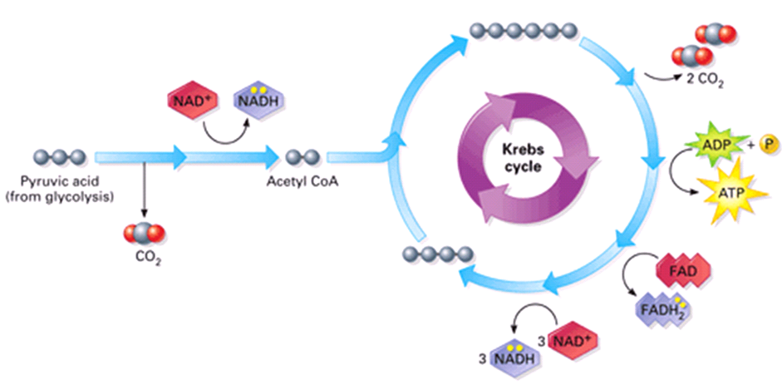
The Krebs Cycle releases energy from Pyruvic acid and produces ATP and CO₂
http://www.science.smith.edu/departments/Biology/Bio231/krebs.html
Notes:
The Krebs cycle only occurs if oxygen is present. If conditions are anaerobic (without oxygen), then fermentation will occur (see slide 21).
The Krebs cycle occurs in the matrix of the mitochondrion. Take note that the matrix is like a soup of chemical necessary for the chemical reactions.
The purpose here is to break pyruvic acid down even further to extract even more energy.
Enzymes first must convert pyruvic acid into another molecule called Acetyl CoA. In doing so, CO₂ is released, and NADH is made.
Then Acetyl CoA enters the matrix and is processed by even more enzymes.
2 more CO₂ are released,
ATP is made
FADH₂ is made
and 3 NADH are made.
These are the products from only one Pyruvic acid molecule. Remember that glycolysis produces 2 pyruvic acid molecules from each glucose molecule. So this means that the Krebs cycle has to “turn” two times to process each glucose molecule
Product totals for each glucose:
8 NADH and 2 FADH₂ (carry the electrons to the Electron transport chain)
6 CO₂ (released as waste)
2 ATP (available for cell work)

Slide 11
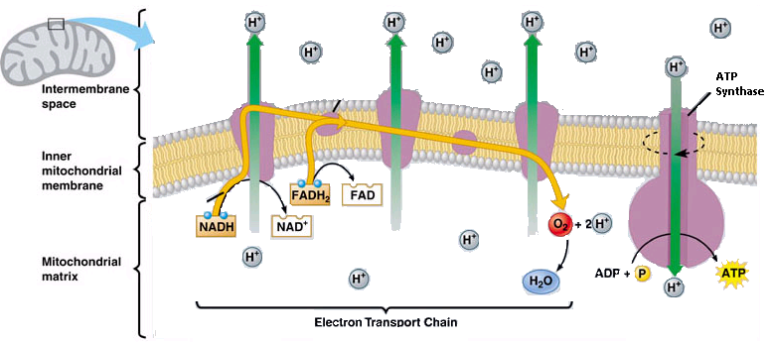
Electron carriers (NADH & FADH₂) generate even more ATP (34) in the Electron Transport Chain.
http://www.science.smith.edu/departments/Biology/Bio231/etc.html
Notes:
The electron transport chain takes place on the inner membrane of the mitochondrion.
Examine the diagram closely. There are membrane phospholipids, protein pumps that use electron energy to pump H+ ions into the intermembrane space and there is a protein channel called ATP synthase which allows the H+ ions to diffuse into the matrix which generates energy to make ATP. (sound like the Light Reactions from Photosynthesis?)
Step 1. NADH and FADH₂ carry electrons from glycolysis and the Krebs cycle to a protein in the inner membrane. (FADH₂ carries its electrons to a protein further along the chain)
Step 2. The electrons travel through the membrane from one protein to the next and the energy from the electrons help the proteins to pump H+ into the intermembrane space (between the inner membrane and the outermembrane)—this builds up the concentration of H+ in the space.
Step 3. As the electrons reach the end of the chain of proteins, they are out of energy and used by oxygen to make water—oxygen is the “final electron acceptor” (Oxygen makes this reaction aerobic, and water is a waste product)
Step 4. The H+ ions have build up in the intermembrane space. They diffuse through ATP synthase back into the matrix. Their flow generates energy to produce ATP.
Energy production: The ETC produces the most ATP in cellular respiration…
1 NADH makes about 3 ATP molecules
1 FADH₂ makes about 2 ATP molecules
So…
Glycolysis makes 2 NADH and 2 ATP
Krebs cycle makes 6 NADH, 2 FADH₂ and 2 ATP
Total = 38 ATP from each glucose molecule

Slide 12
Fermentation
Anaerobic or aerobic??
In cytoplasm
Produces 2 ATP
Alcoholic (ethanol and CO₂)
Yeast making bread dough rise
Lactic Acid
In muscles during exercise
Notes:
Yeast: CO2 bubbles make air spaces in bread
Muscles: burn you feel because muscles can’t get enough oxygen

Slide 13
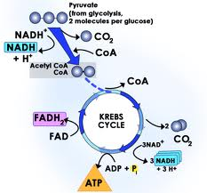
Krebs cycle
In matrix of mitochondria
Produces 2 ATP

Slide 14
How much energy do we make?
In Cellular Respiration
Anaerobic
Glycolysis- 2 ATP
Fermentation- 0 ATP
Total- 2ATP
Aerobic
Glycolysis- 2 ATP
Krebs Cycle- 2 ATP
ETC- 34 ATP
Total- 38 ATP

Slide 15
Glucose
Summary
Glycolysis
(Net)
2 ATP
Without O₂
With O₂
Pyruvate
Fermentation
Kreb’s Cycle
2 ATP
Alcoholic
ETC
34 ATP
Lactate
Ethanol & CO₂
Aerobic Respiration
Anaerobic Processes
(Produces the greatest amount of ATP!)
(Cells make a limited # of ATP)

Slide 16
Comparison of: Photosynthesis vs. Cellular Respiration
 | Photosynthesis | Cellular Respiration
Function | Make Glucose | Glucose into Energy
Location | Chloroplast | Mitochondria
Cell Type | Plant Cells, algae | ALL Eukaryotes, some prokaryotes
Processes that occur | Light Reactions Calvin Cycle- (Dark Reactions) | Glycolysis or Glycolysis Krebs Cycle Fermentation ETC
Equation | 6CO₂ +6H₂O C₆H₁₂O₆ +6O₂ | C₆H₁₂O₆ +6O₂ 6CO₂ +6H₂O

Slide 17
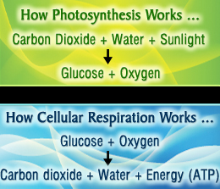
Photosynthesis vs respiration!!

